Slide 1
SMART Goals
Focus on results-oriented goals rather than process-oriented goals.
This is one of the most challenging components of a SMART Goal to write.
Notes:
When drafting a goal, a focus on results rather than process, leads to clarity in actions and effective steps towards attainment of the goal.
A Process example would be to
Develop a plan for… improving RTI - Response to Intervention-results
A Results focused example would be:
Communication efforts will increase from 1 contact each month to 2 per month as indicated by emails, phone call logs and posted Wiki messages…
*

Slide 2
Assessing SMART Goals: Results vs. Process
“Results goals
focus on the
desired result itself,
not the ‘process’
or the means they assume necessary to
achieve that result.”
Peter Senge, 1990. The Fifth Discipline.
Notes:
*

Slide 3
Process vs. Results Means vs. Ends
Implement an integrated math /science curriculum for PK-2.
Develop a balanced literacy program for primary students.
Adopt the letter people program for all PK classrooms.
Reduce failure rate in math for all 6th grade students.
Increase the number of students who are reading at benchmark by the end of 1st grade.
Eliminate violent behavioral incidences.
Notes:
Take a look at the differences in Process (the means and actions needed to get to a goal) and Results (the end goal achievement). What are some additional examples?
*

Slide 4
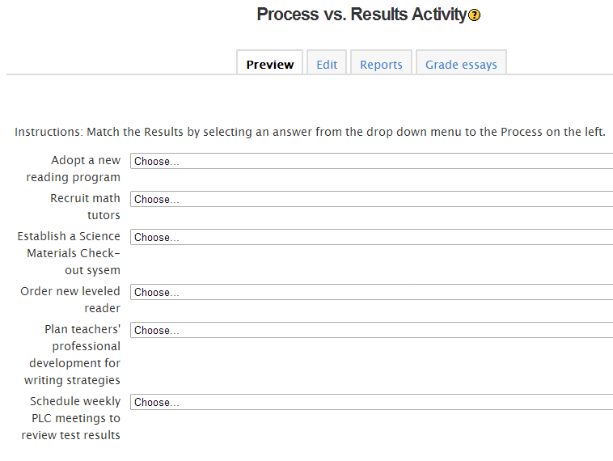
Process or Results?
Go to the Next Button to complete the Process or Results activity.

